Slide 1
Unified STM data pipeline : Building ML-ready datasets to connect AI to STM
Dec.5, STM group meeting
Jewook Park
CNMS
Notes:
Accessing Title Slide Options The standard ORNL presentation template includes five branded title slide layouts:
Title | Standard. The preferred layout for lab-wide and general presentations. Features a default aerial photograph of the lab.
Title | Custom Image. Allows replacement of the default background with a custom full-slide image (16:9 or 4:3 landscape format).
Title | Custom Portrait Image. Supports inclusion of a custom 4:3 portrait image positioned next to the introductory text.
Title | Custom Landscape Image. Supports inclusion of a custom 16:9 landscape image positioned next to the introductory text.
Title | Text Only. Offers additional space for longer titles and multiple presenters.
Additional Lab-approved title slides specific to directorates and user facilities are available in PowerPoint under the following folders: Custom Title Slides and User Facility Templates, located in Presentation Templates.
Custom Title Slide Guidelines
Image Rights. Any custom images, graphics, or photography must be owned by ORNL or used with documented permission from the original creator or source.
Appropriate Image Use. Select images that work well with the layout. Ensure the focal point of the image is not obscured by the title text and white overlay box.
Relevance and Impact. Visuals are a key element of effective communication. Whenever possible, use imagery that enhances the message of your presentation and reflects ORNL’s mission and values.
Quality and Clarity. Use high-resolution images for clarity on large screens. Avoid overly complex or dark images that may conflict with the title text.
Text-Only Option. If no appropriate or approved imagery is available, or if imagery is not permitted for the subject matter, the Title | Text Only layout provides a clean, professional alternative.
Learn more about ORNL presentations
https://ornl.sharepoint.com/sites/branding/SitePages/presentations.aspx

Slide 2
Why do we need a unified STM data pipeline and ML-ready feature sets?
AI/ML unlocks advantages in STM research
Automated control outperforms humans in speed, precision, and long-iteration tasks
AI-assisted data processing can handle multidimensional datasets (data arrays + metadata) and extract features in image/spectroscopy data.
AI/ML need ML-ready data (unified/structured/processed features)
Domain experts should prepare the connection to AI (learning AI tools & building a domain-specific bridge)
AI experts cannot build domain specific pipelines for every fields.
Standardized STM datasets and workflows
Cross-platform STM instruments (Nanonis, Matrix, SNVM) with incompatible formats
Mixed analysis methods (GUI(Nanonis, WSxM , Gwyddion, … ) + scripting(Python, MATLAB, Mathematica, … )
Cross-platform STM Instruments
Nanonis(VT, JT, HF,4P,JT, Infinity, mK … )
Omicron (4P)
SNVM
Mixed Analysis Methods
Graphic User Interface (GUI): Nanonis, WSxM , Gwyddion, XPMpro, …
Scripting-based: Python, MATLAB, Mathematica, ImageJ, Igor, Origin, R, C, Fortran, …
Python
Open Source: Cost effective, massive community, AI coding assistance
Transparent Collective Intelligence: Continuous improvements and documentation
Agile Integration of Advanced AI/ML: implementing advanced AI/ML capabilities & image processing

Slide 3
Unifying STM data analysis into a flexible and adaptable workflow to connect AI to STM research
Flexible Modules
Adaptable Architecture
ML-ready Workflow
Unified data structure -Adaptable to any STM dataset
Modular analysis tracks - Preprocessing / feature extraction / visualization / ROI / ML - Versatile routing (rearrange, bypass, repeat, … ) - Support new module developments
Compatibility - Cross-instrument / cross-sample - Multi-channel analysis (topography, LDOS, thermal voltage, … ...) - Reusable and expandable modules
Scalable design - Dimensionality-independent (point/line/map) - Cross-channel correlation search (2D/3D, … ) - Support large size data (parallel-computing–compatible data format)
Sustainability - Rapid adaptation to new instruments or experimental modes
Standardized feature set - Stacked table of feature set accelerate AI/ML integration - Interpretable feature sets compatible with ML packages (clustering (PCA/ UMAP), classification(kNN, HDBSCAN), …)
Bridging STM expertise and AI methodology - Automated data processing - Integration of real-time, AI-assisted analysis for STM experiments - LLM for STM experiments

Slide 4
How to use?
Environment setting
Jupyter Lab
Analysis
Future
Anaconda (need subscription)
UV (pip only )
Miniforge (pip+conda/mamba)
Check miniforge installation document by Jewook.
Run Jupyter lab
Environment check
Load data
Data analysis (ipynb)
+ library
Multi dimensional data
Image processing
Feature extraction
+ AI/ML
Towards
STM-Specialized
Agent AI

Slide 5
Demonstration

Slide 6
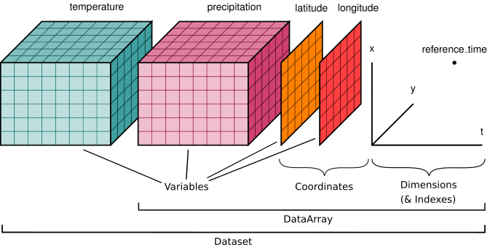
Why Xarray?
Extends NumPy & Pandas to multi-dimensional data
Excellent compatibility with the scientific Python ecosystem (SciPy, dask, matplotlib, pint, etc.)
metadata support (coordinates, dimensions, attributes)
Well defined built-in functions: differentiation, statistics, slicing, visualization
Reliable scientific I/O (NetCDF), easy conversion to Zarr/HDF5/CSV
Parallel & scalable computation via full dask integration

